Slide 1
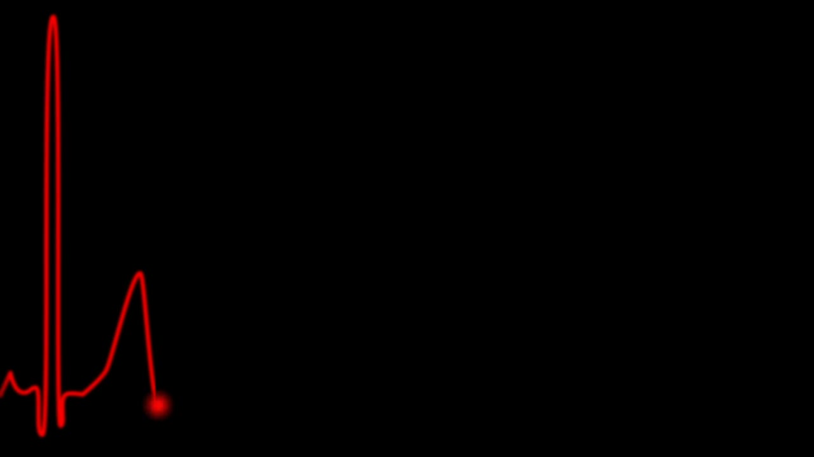

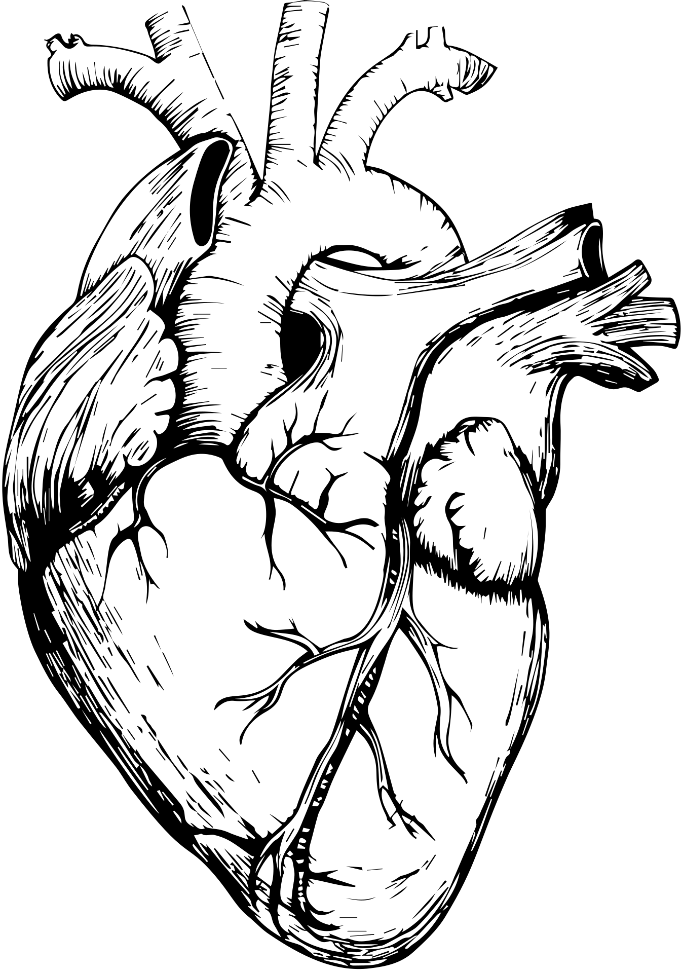
HEART DISEASE ANALYSIS
Karthick.T
RP-33
DA/DS

Slide 2

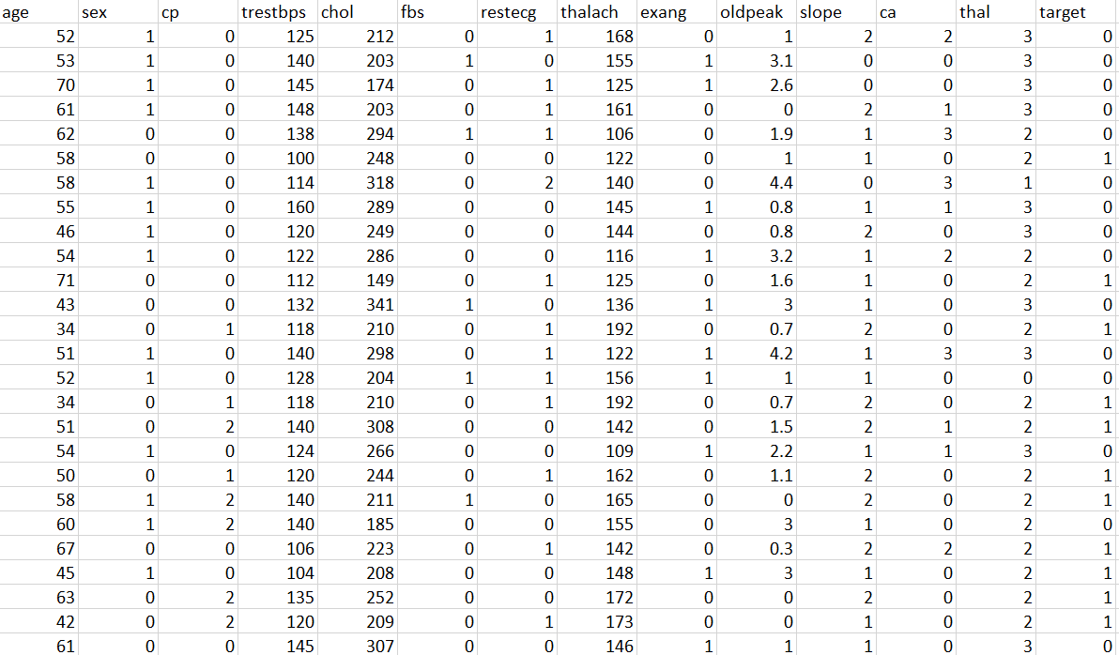
Data Contains
1.Age
2.Sex
3.Chest Pain Type
4.Resting Blood Pressure
5.Cholestoral
6.Fasting Blood Sugar
7.Restecg
8.Thalach
9.Exang
10.Oldpeak
11.Slope
12.Vessels
13.Thal
14.Target

Slide 3
Data Contains
1.Age
2.Sex
3.Chest Pain Type
Typical angina
Atypical Angina
Non-Anginal pain
Asymptomatic Angina
4.trestbps
Trestbps stands for Resting Blood Pressure (in mmHg).
Normal: < 120/80 mmHg
Elevated:120-129/<80 mmHg
Hypertension Stage 1: 130-139/80-89 mmHg
Hypertension Stage 2: ≥ 140/90 mmHg

Slide 4
Data Contains
5.chol
serum cholestoral in mg/dl
Desirable : < 200 mg/dL
Borderline High : 200 - 239 mg/dL
High : ≥ 240 mg/Dl
7.restecg
resting electrocardiographic results (values 0,1,2)
0 = Normal ECG
1 = ST-T wave abnormalities (Possible signs of heart disease, like ischemia)
2 = Left Ventricular Hypertrophy (LVH) (Thickening of the heart’s left ventricle, often due to high blood pressure)
6.fbs
fasting blood sugar > 120 mg/dl
0 = Normal or Prediabetes
1 = Diabetes

Slide 5
Data Contains
8.Thalach
Thalach stands for Maximum Heart Rate Achieved during a stress test or physical activity.
10.oldpeak
Oldpeak refers to ST Depression Induced by Exercise Relative to Rest in an ECG (Electrocardiogram).
0.0 mm = No ST depression (Normal)
0.1 - 2.0 mm = Mild ST depression (Possible heart issue)
> 2.0 mm = Significant ST depression (Higher risk of heart disease)
9.Exang
Exang stands for Exercise-Induced Angina (chest pain caused by exercise).
0 = No exercise-induced angina (Normal)
1 = Exercise-induced angina (Possible heart issue)

Slide 6
Data Contains
11.slope
Slope refers to the slope of the ST segment in an electrocardiogram (ECG) during peak exercise.
0 = Upsloping (Lower risk, often normal)
1 = Flat (Possible heart disease, concerning)
2 = Downsloping (Higher risk of heart disease)
12.ca
Ca (Number of Major Vessels) Explanation:
0 = No major vessels affected
1, 2, 3 = Increasing number of major blood vessels affected
A higher value means more blocked or narrowed vessels, indicating a higher risk of heart disease.

Slide 7
Data Contains
13.Thal
“thal” refers to a type of thallium stress test result, which assesses how well blood flows to the heart during exercise.
0 = Unknown
1 = Normal (no stress-induced defect)
2 = Fixed Defect (old heart attack; dead tissue that doesn’t get blood)
3 = Reversible Defect (blood flow is only reduced during stress; possible ischemia)
14.Target
refers to the presence or absence of heart disease
0 = Absence
1 =Presence

Slide 8
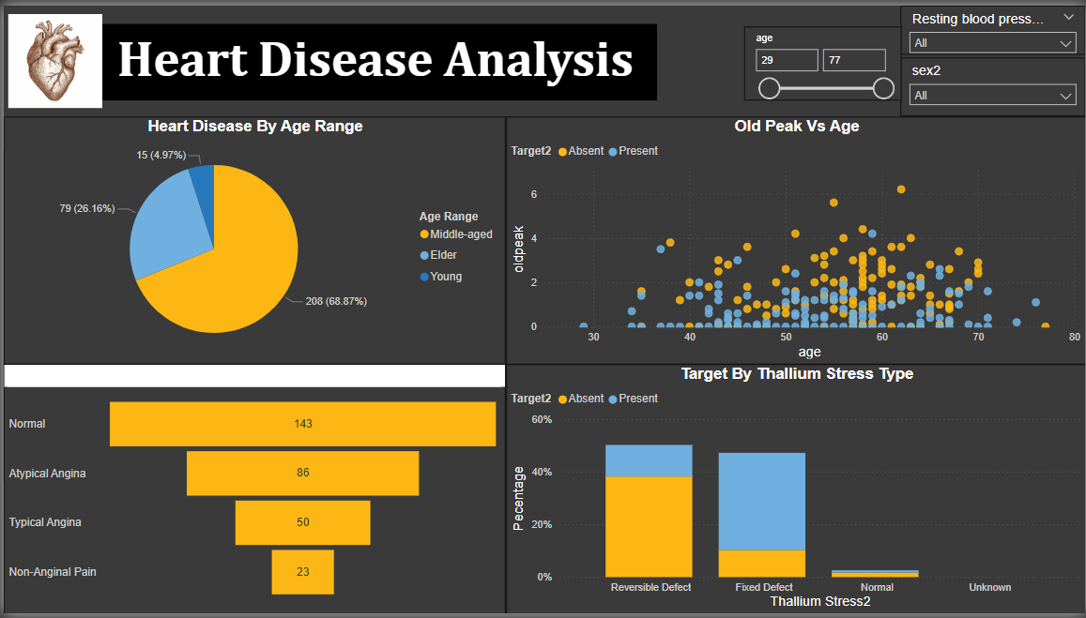
2

Slide 9
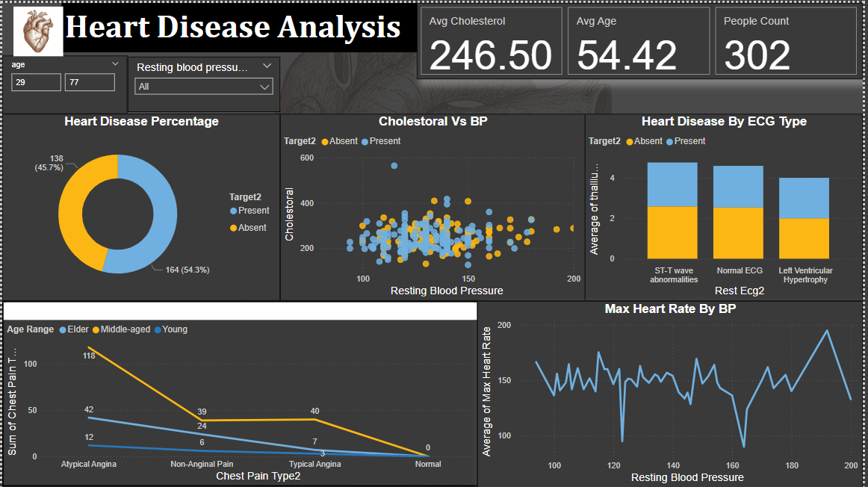
2

Slide 10
Future Recommendation
Promote education on diet, exercise, smoking risks, and mental health.
Encourage regular heart check-ups, even without symptoms.
Diet: Encourage a heart-friendly diet .
Exercise: Recommend at least 150 minutes/week of moderate activity.
Sleep: Emphasize the role of quality sleep in heart health.
Stress management: Support practices like mindfulness and yoga.
Expand use of wearables (Fitbit, Apple Watch) to monitor:
Heart rate
Blood pressure

Slide 11

THANK YOU ALL

